Slide 1

PQC Sentinel
Quantum-Agile Gateway Defense for Digital Public Infrastructure

Slide 2
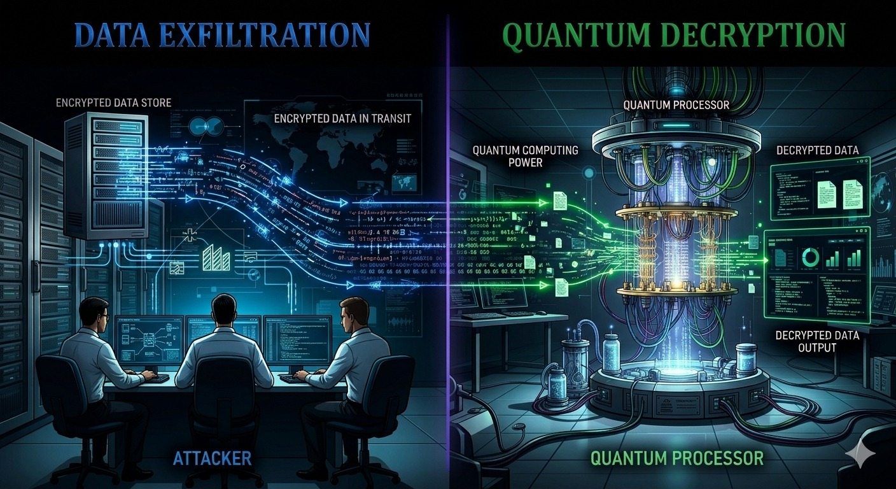
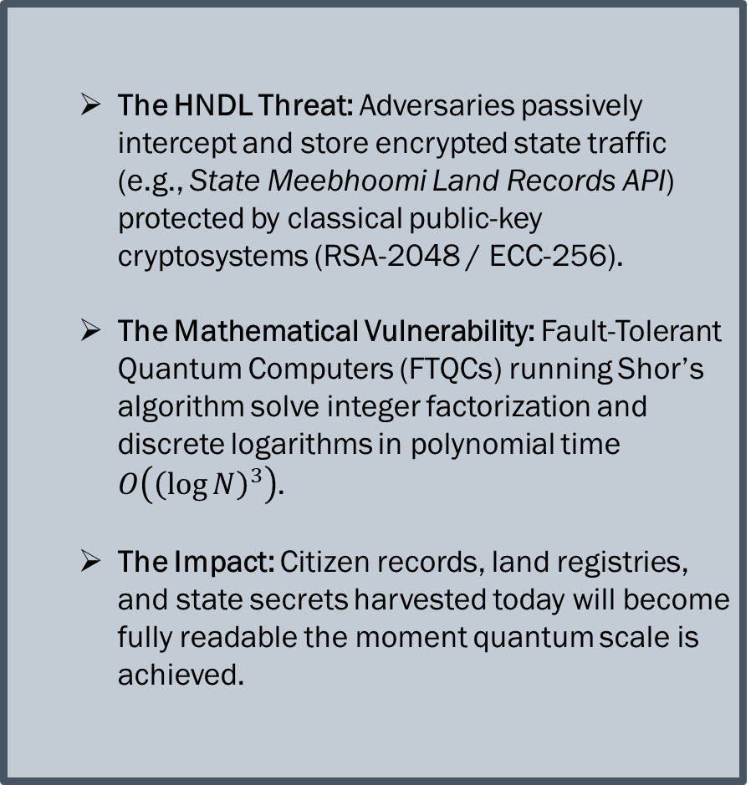
SOURCE : GEMINI
STATEMENT : Post-quantum cryptography (PQC) migration for government systems
The HNDL Threat: Adversaries passively intercept and store encrypted state traffic (e.g., State Meebhoomi Land Records API) protected by classical public-key cryptosystems (RSA-2048 / ECC-256).
The Mathematical Vulnerability: Fault-Tolerant Quantum Computers (FTQCs) running Shor’s algorithm solve integer factorization and discrete logarithms in polynomial time $O\left({\left(\log{N}\right)}^{3}\right)$.
The Impact: Citizen records, land registries, and state secrets harvested today will become fully readable the moment quantum scale is achieved.

Slide 3
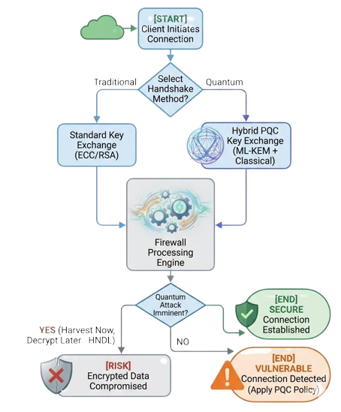
EXISTING SOLUTIONS :
Module-Lattice-Based Key-Encapsulation Mechanism Standard ( FIPS 203 ) : key-encapsulation mechanism (KEM) is a set of algorithms that, under certain conditions, can be used by two parties
Module-Lattice-Based Digital Signature Standard (FIPS 204):Digital signatures are used to detect unauthorized modifications to data and to authenticate the identity of the signatory.ML-DSA is believed to be secure, even against adversaries in possession of a large-scale quantum computer
LOOPHOLES :
Loophole 1 (Algorithm Vulnerability): Existing TLS/IPsec tunnels rely on RSA/ECC key exchanges that completely lack lattice-based post-quantum mathematical resistance.
Loophole 2 ( Behavioral Blind Spot): Standard web application firewalls (WAFs) fail to detect micro-exfiltration patterns embedded inside legitimate API calls
SOURCE : GEMINI

Slide 4
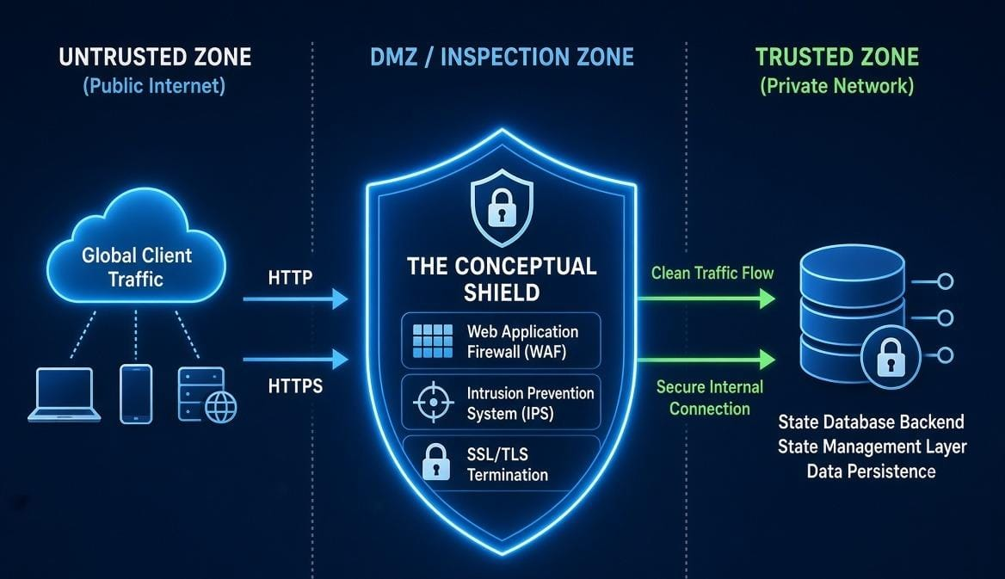
PQC Sentinel: Quantum-Agile Gateway Defense
OUR SOLUTION
Zero-Touch Integration: Operates as a crypto-agile reverse proxy layer (OpenSSL 3.0 / oqs - provider), requiring zero code changes to legacy backend databases.
Pure Quantum Execution Engines: Driven natively by Qiskit quantum circuits for threat modeling and automated 8-qubit QRNG seed generation.
Automated Mitigation: Instantly intercepts bulk exfiltration, hot-swaps session keys to NIST ML-KEM-768, and injects decoy honeypot bytes into the attacker’s buffer.
SOURCE : GROK

Slide 5
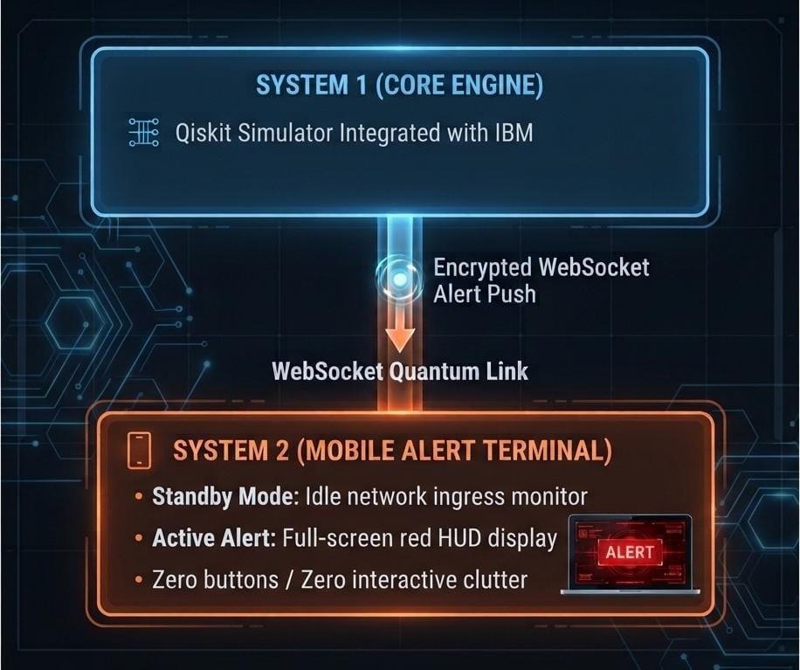
Dual-Node Architecture & Signal Flow
System 1 (Backend Node): Executes Qiskit simulation algorithms, processes threat analytics, and manages session key rotation.
System 2 (Mobile HUD Node): Dedicated mobile display node that receives low-latency event pushes from System 1.
Data Flow:
Attack trigger on System 1
Encrypted alert payload emitted over WebSocket
Immediate full-screen HUD popup on System 2.
SOURCE : GEMINI

Slide 6
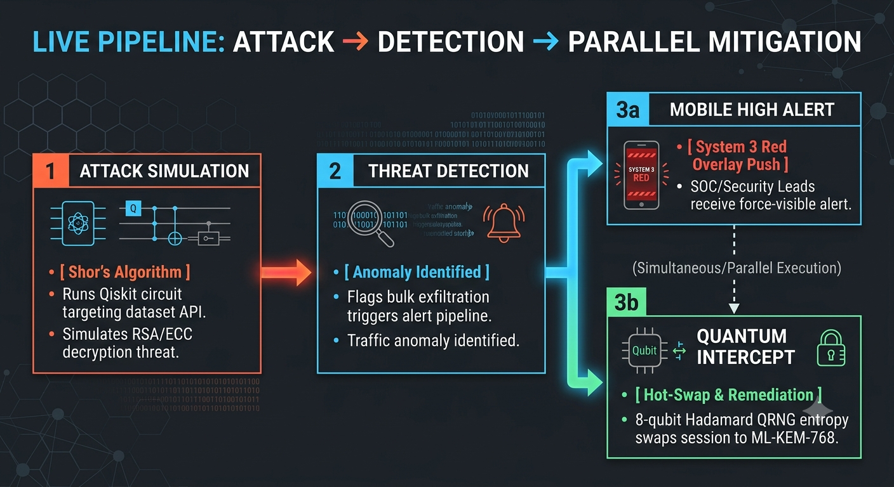
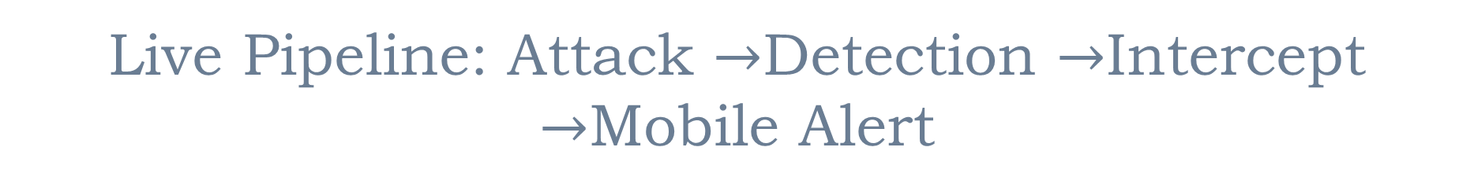
Live Pipeline: Attack $→$Detection $→$Intercept $→$Mobile Alert

Slide 7
THANK YOU

